Slide 1
Airline Review Analysis
Evaluating the ML Model

Slide 2
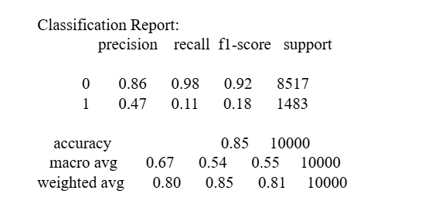
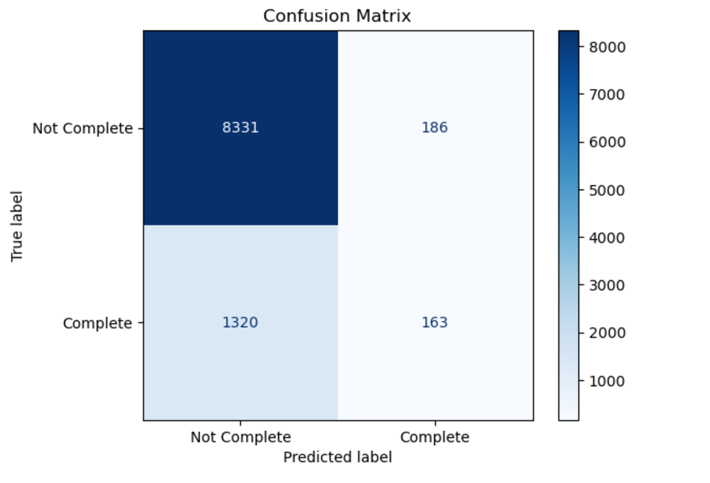
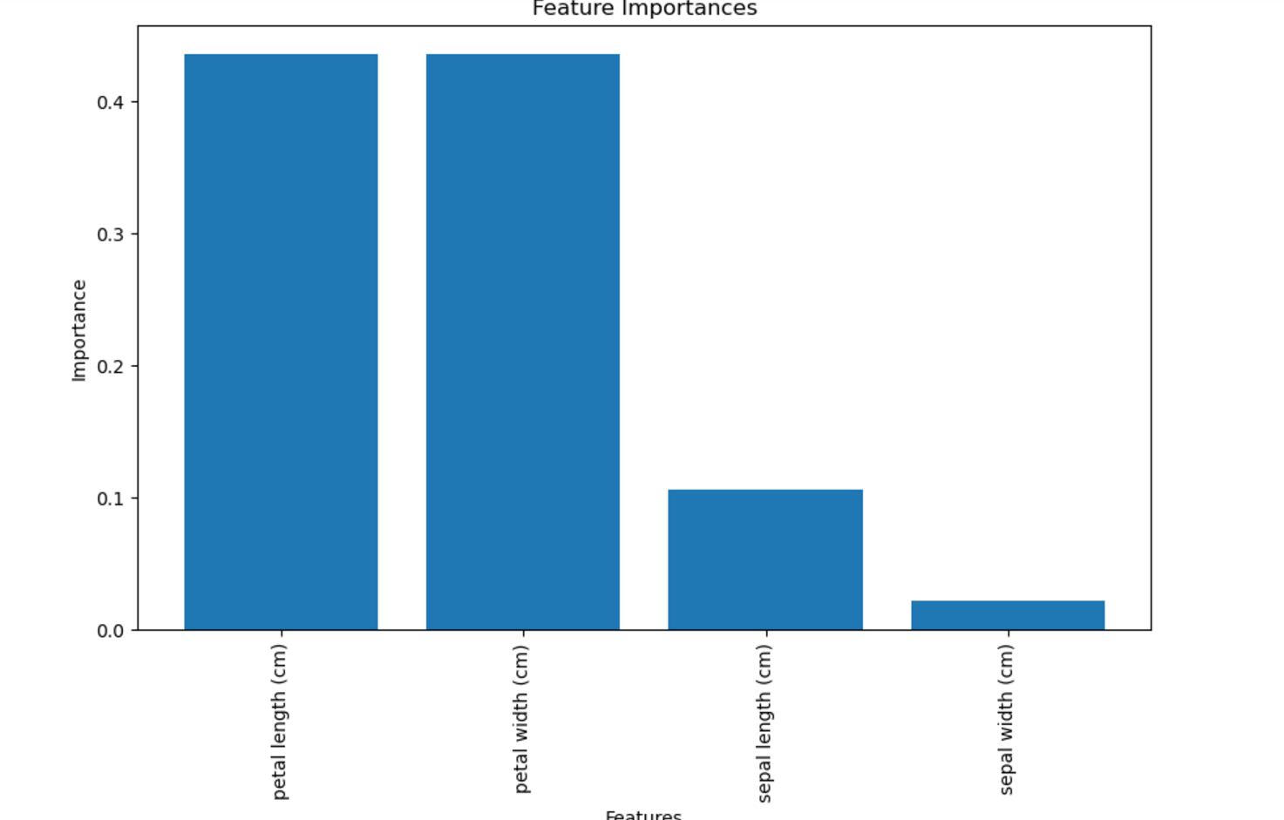
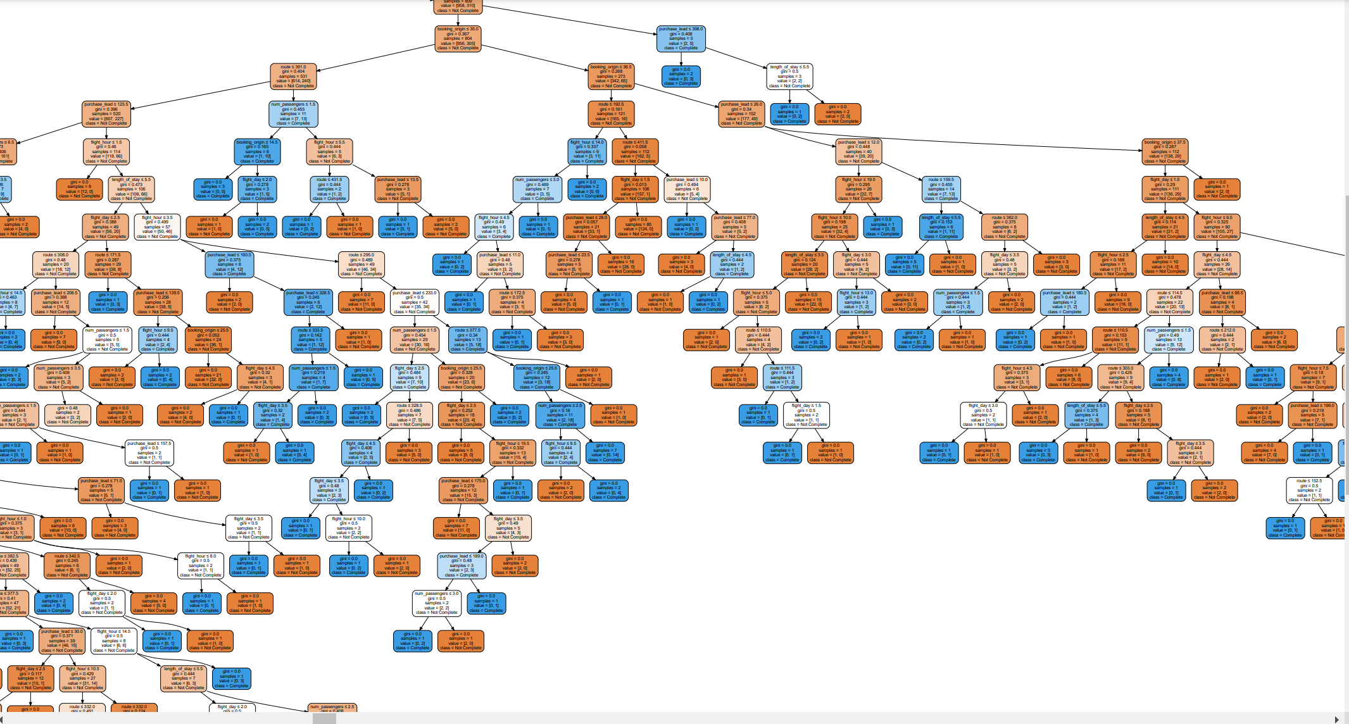

Model and findings
From the classification report, this is a model with good performance for predicting class 0 (with high precision and recall), but it seems to struggle with class 1,showing very low recall (0.11) and precision (0.47). This could indicate class imbalance, where the model is biased towards predicting the majority class (0), which is often the case in datasets with imbalanced classes. Route, length of stay and flight hour are the most contributing features. The is a lower number of customers buying holidays.

